Slide 1
Query optimization
Notes:
By: Yogesh Mehla
Skype: Yogesh.mehla@live.com
Emal: Yogesh.Mehla@gmail.com
Phone: +91-9023262520
Website: www.sqlyogi.com
www.techsapphire.net
www.techsapphire.in

Slide 2
Execution Plan
Optimization Dictionary
A query plan (or query execution plan) is an ordered set of steps used to access data in a SQL relational database management system.
Execution Plan
Statistics time/io

Slide 3
Expensive operators
Optimization Dictionary
Spooling: Duplicate aggregation
Hashmatch: Un-sorted data
Keylookup: Missing data
Execution Plan
Statistics time/io
Spooling
Hashmatch
Keylookup

Slide 4
Bad Views
Optimization Dictionary
Views are often used to simplify queries and increase reusability. But some times they end up performing bad.
Execution Plan
Statistics time/io
Spooling
Hashmatch
Keylookup
Bad Views

Slide 5
Unnecessary sub queries
Optimization Dictionary
Some times multiple sub queries can be replaced with single sub query.
Reason: Lazy developers
Execution Plan
Statistics time/io
Spooling
Hashmatch
Keylookup
Bad Views
Sub queries minimization

Slide 6
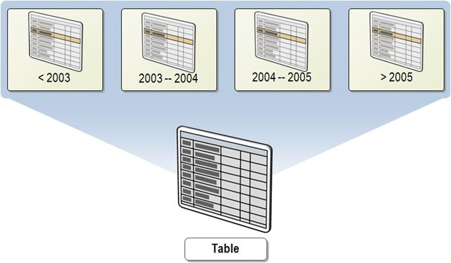
Partition Elimination

Slide 7
Partition Elimination
Optimization Dictionary
All indexes should align to partition scheme.
Queries should align to partitioning.
Thumb rule is, parameter variables should have same data type as column.
Don’t use functions on partition column
Execution Plan
Statistics time/io
Spooling
Hashmatch
Keylookup
Bad Views
Sub queries minimization
Partition Elimination

Slide 8
SARGable query
Optimization Dictionary
SARG: Search Argument
Non SARGable queries (Zombie queries)
Main reason for forcing Hashmatch
Execution Plan
Statistics time/io
Spooling
Hashmatch
Keylookup
Bad Views
Sub queries minimization
Partition Elimination
Sargable query
Index Scan
Index Seek

Slide 9
Miscellaneous tips
Optimization Dictionary
Avoid external grouping
Cross apply vs UNPIVOT
Rownumber vs OFFSET & FETCH
RANK vs Sub Query
Power of OVER clause
Execution Plan
Statistics time/io
Spooling
Hashmatch
Keylookup
Bad Views
Sub queries minimization
Partition Elimination
Sargable query
Index Scan
Index Seek

Slide 10


